Slide 1


SAP S/4HANA CDS, BTP Full Stack Training Day 19
Anubhav Oberoy

Slide 2

Day 19
Unmanaged RAP implementation
Create Travel Entity
Create Service
Create Display Only List Report
Create Fiori App
--break
Create unmanaged Implementation
Implementation logic
ABAP on Cloud Environment
--
ABAP git in on-premise
Move code from on-premise to cloud
CI/CD
Assessment
Notes:
https://unsplash.com/photos/CPs2X8JYmS8

Slide 3
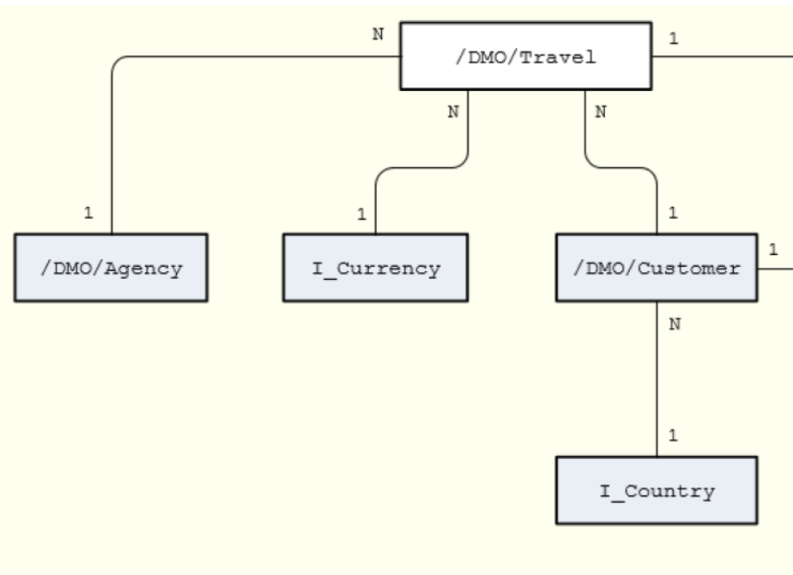

Unmanaged RAP
The scenario described below focuses on an unmanaged implementation type of a business object provider in the context of the ABAP RESTful programming model.
For the unmanaged implementation type, the application developer must implement essential components of the REST contract itself. In this case, all required operations (create, update, delete, or any application-specific actions) must be specified in the corresponding behavior definition before they are manually implemented in ABAP.
The figure below shows the relationships between the travel, agency and customer entities where the travel entity represents the root of the data model. Additional entities for currencies (I_Currency) and countries (I_Country) are generally available in your system and are included in our data model using associations.
www.anubhavtrainings.com

Slide 4
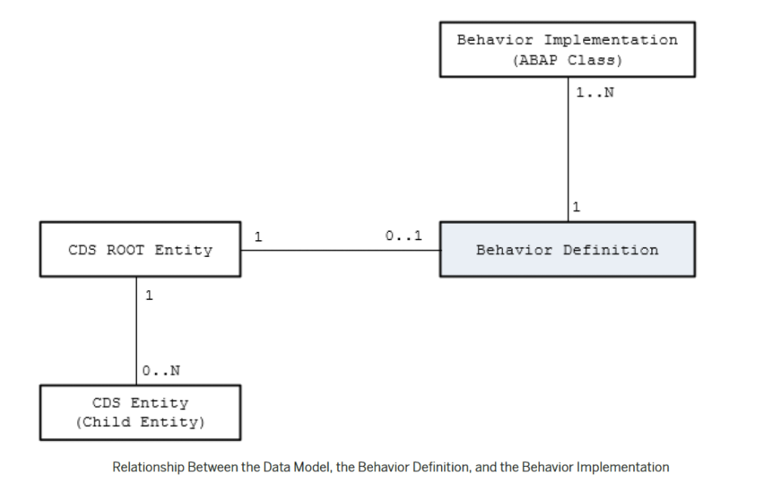
Behavior Definition
A business object behavior definition (behavior definition for short) is an ABAP Repository object that describes the behavior of a business object in the context of the ABAP RESTful programming model.
A behavior definition is defined using the Behavior Definition Language (BDL) and comprises capabilities and modelling aspects of the business object node or nodes, for example the supported operations (such as create, update, and delete actions) or the definition of lock dependencies between the parent and child nodes.
A behavior definition always refers to a CDS data model. This reference results from the name equality with the root entity. This means that a CDS data model must always exist before the behavior definition is created.
A behavior definition relies directly on the CDS root entity.
One behavior definition refers exactly to one root entity and one CDS root entity has a maximum of one behavior definition (a 0..1 relationship), which also handles all associated (child) entities.
The implementation of a behavior definition can be done in a single ABAP class (behavior pool) or can be split between an arbitrary set of ABAP classes (behavior pools). You can assign any number of behavior pools to a behavior definition (a 1: n relationship).
www.anubhavtrainings.com

Slide 5
Behavior Pool
The transactional behavior of a business object in the context of the current programming model is implemented in a global ABAP class or classes. These special classes are dedicated only to implementing the business object’s behavior and are called behavior pools.
the implementation of a behavior definition can be done in one class or split across an arbitrary set of ABAP classes.
You can assign any number of behavior classes to a behavior definition (a 1: n relationship). Within a single global class, you can define multiple local classes that handle the business object’s behavior.
The global class is just a container and is basically empty while the actual behavior logic is implemented in local classes.
Local class 1 for Entities
Behavior Definition
Class Pool
Local class 2 for Entities
Local class 3 for Entities
www.anubhavtrainings.com

Slide 6
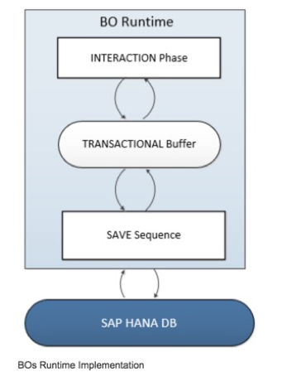
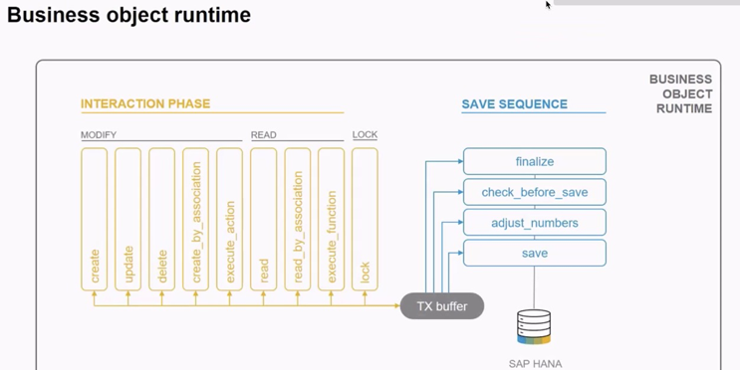
BO Runtime
The business object runtime mainly consists of two parts: The first part is the interaction phase where a consumer calls the business object operations to change data and read instances with or without the transactional changes. The business object runtime keeps the changes in its internal transactional buffer which represents the state of the instance data. This transactional buffer is always required for a business object. After all changes were performed, the data can be persisted. This is realized with the save sequence.
www.anubhavtrainings.com

Slide 7
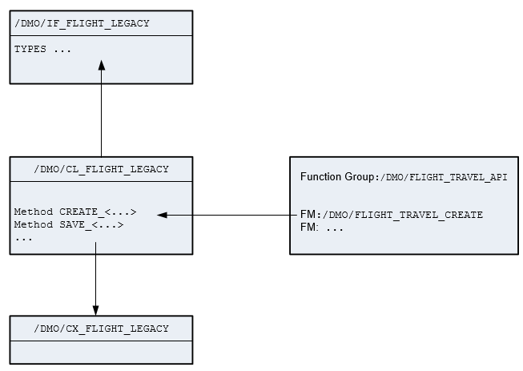
Business Logic
he following figure summarizes the essential elements of the business logic:
The function group /DMO/FLIGHT_TRAVEL_API is used to group all function modules that represent the application’s legacy code.
The class /DMO/CL_FLIGHT_LEGACY provides the actual implementation of the business logic in a more convenient (object-oriented) way.
The interface /DMO/IF_FLIGHT_LEGACY defines global types and constants for reuse.
Exception class /DMO/CX_FLIGHT_LEGACY.
www.anubhavtrainings.com

Slide 8
What is %CID
%CID stands for the content ID and is used in an OData request to bind the result of an operation to a name so that it can be referenced in another operation later in the transactional processing.
In some use cases, it may happen that a consumer works with data that is not yet persisted and might not have a primary key yet. The primary key can be created in the <method> FOR MODIFY call or later in the save sequence (late numbering). In such cases, a temporary primary key, the content ID (%CID) for an instance, is used as long as no primary key was created by BO runtime. The content ID is consequently also used then as a foreign key.
www.anubhavtrainings.com

Slide 9
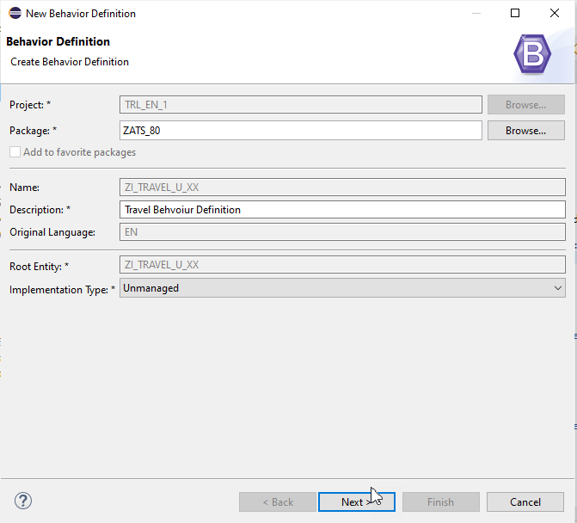
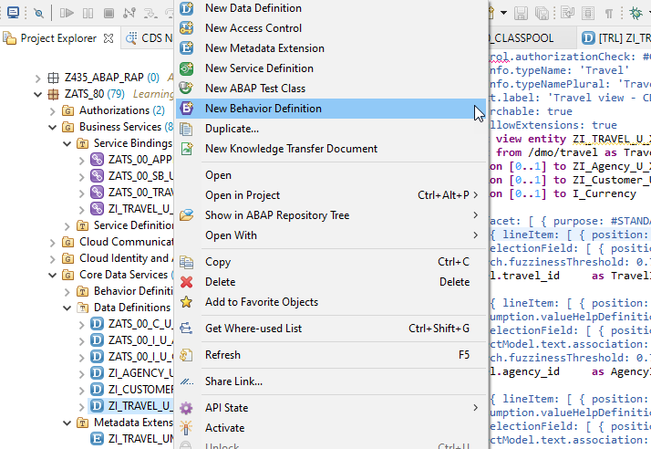
Hands-on : Create CDS Entity and BDEF
www.anubhavtrainings.com

Slide 10
Fiori App
OData
RAP
B-IMP
Legacy Code
post
Agency customer id
Start date
End date
Create
Create IMPORT
Entities (%cid)
Write to TB
messages
save
Save to DB
cleanup
www.anubhavtrainings.com

Slide 11

ABAP on Cloud
ABAP on cloud is an ABAP environment running on SAP BTP on top of AWS infrastructure. It is a shared ABAP system in trial mode.
Since it’s a shared system with other abap trial users, we will see all the packages of other users as well.
With ABAP on Cloud, NO ONE EVER-EVER access SAPGUI, No tcodes are allowed with GUI. In fact, you cant event use SAPGUI to connect to ABAP on Cloud system
We don’t have control to install notes, patches, and upgrade
No access to SPRO (customizing) is allowed in the cloud
ABAP on Cloud is just abap environment, its not a SAP Solution (like s/4hana or ecc), so you will never find standard sap tables like MARA, VBAK, ACDOCA, MATDOC etc.
You are only allowed to use DDIC objects which are marked released
We cannot create everything like what we do in a on-premise system e.g. forms, workflow, scripts, dialog prog.
We cannot create ABAP programs in the AoC system, all code will be in-form of classes.
The AoC only allows whitelisted ABAP statements, no other abap statements can be used freely e.g. write.
https://help.sap.com/docs/sap-btp-abap-environment?locale=en-US
You can create your packages under a standard package ZLOCAL
The preferred programming model to develop applications is RAP – Restful Application Programming model
ABAP in Cloud has a code name called “steampunk”
www.anubhavtrainings.com

Slide 12
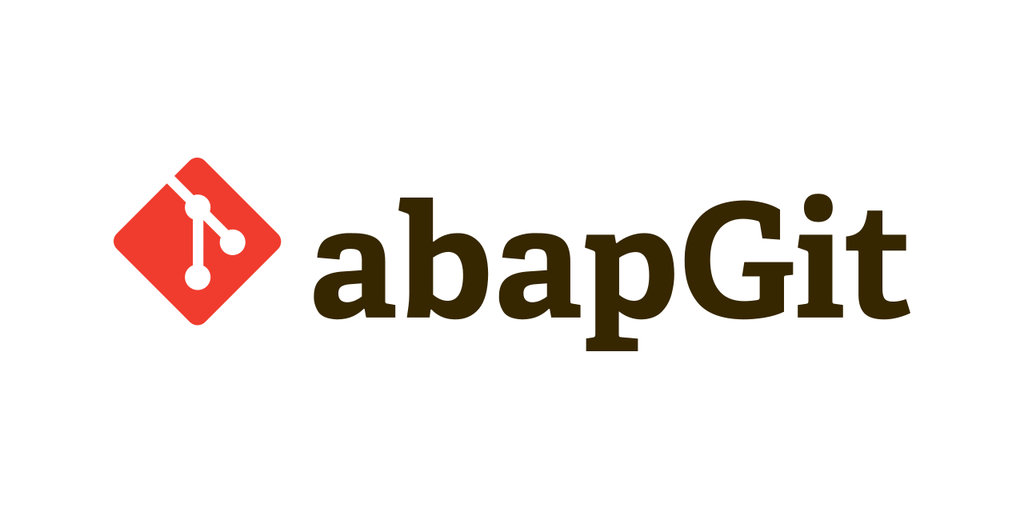
ABAP git
abapGit is a git client for ABAP developed in ABAP. It requires ABAP version 702 SP 8 or higher.
Latest build: zabapgit_standalone.prog.abap
abapGit is a tool to import and export code between ABAP systems. If a developer has a developer key to the system, the developer can perform these actions already. abapGit enables the developer to do mass export/changes/imports but not more than already possible to do manually.
Running automated security checks on the abapGit code will by design give a lot of errors, as abapGit will import, overwrite and change ABAP artifacts in the system in ways that might not be intended. Always review all code in remote repositories before importing to the target system, this is possible because abapGit is plain text unlike traditional transport files.
www.anubhavtrainings.com

Slide 13
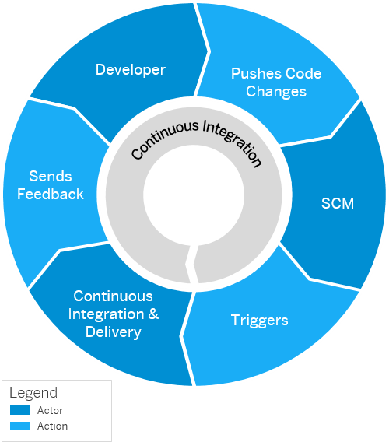
Continuous Integration and Delivery (CI/CD)
Configure and run predefined continuous integration and delivery (CI/CD) pipelines that automatically build, test, and deploy your code changes to speed up your development and delivery cycles.
Continuous integration (CI) describes a software development process, in which various team members integrate their contributions frequently into a single main line. Before each integration, the changes are verified through builds and automated testing. Thereby, you can detect errors as quickly as possible and prevent integration problems before completing the development.
The continuous delivery (CD) concept expands on the one of continuous integration. It adds the aspect that any change that has successfully passed the tests is immediately ready to be deployed to production, both from a technical and a qualitative point of view.
www.anubhavtrainings.com

Slide 14
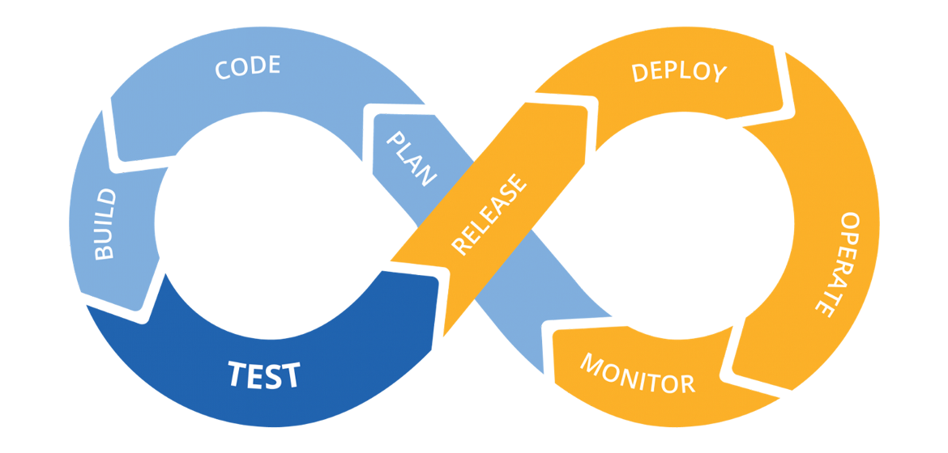
CI/CD pipeline
www.anubhavtrainings.com

Slide 15
Assessment
Content
www.anubhavtrainings.com

Slide 17

Questions?

Slide 18


Thank you
Anubhav.abap@gmail.com
contact@anubhavtrainings.com
+91 84484 54549
www.anubhavtrainings.com

